Slide 1
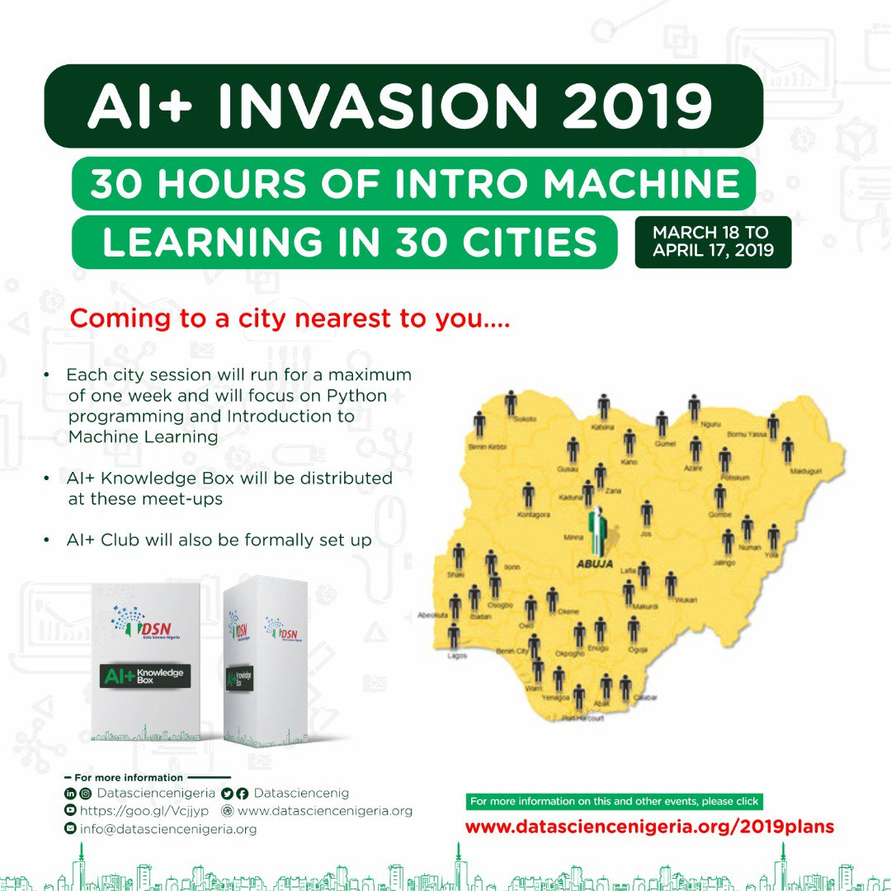
AI-INVASION 2019
A 5 day Introduction to Python and Machine Learning
A Presentation by Rising Odegua

Slide 2


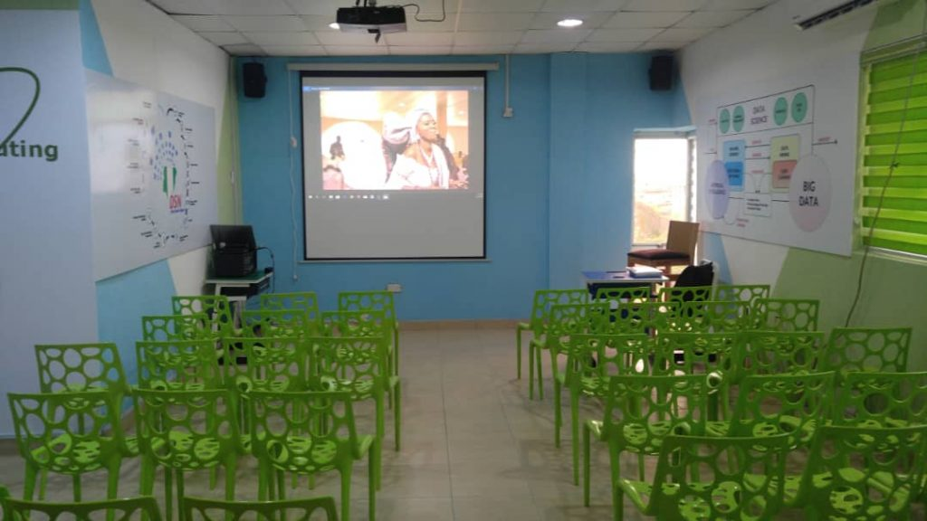
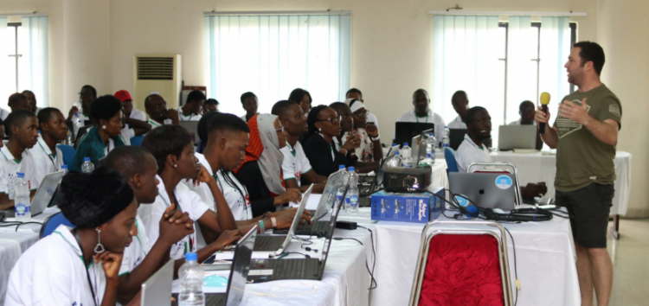
About Data Science Nigeria
Data Science Nigeria is a non-profit driven by a vision to build a world-class Artificial Intelligence knowledge, research and innovation ecosystem that delivers high impact research, business use applications, locally-relevant AI-first start-ups, increase employability and drive for social good use cases.
FOUNDED BY
DR BAYO ADEKANMBI
CTO MTN NIGERIA

Slide 3
KEY MILESTONES OF DSN
300,000+ direct download of our Artificial Intelligence for Starter free ebook with contribution from recognized leaders like Prof Yoshua Bengio .
10,212 participated in the 1st ever Intercampus Machine Learning competition that involved 95 universities.
12,234 online participants in Data Science course
Over 1,000 have participated in our face to face classes via fully residential all-expense-paid bootcamp, free meet-ups and weekly classes at the AI Hub.
203 direct job placement, project participation and internship.
4 innovative product ideas that are being pre-incubated
The largest convergence of academia and industry practitioners as mentors to support real-world application of learning.
High impact learning bootcamps, academic engagement and direct job placements (full time, freelance and internships) for young Nigerian data scientists
Strategic partnership with leading firms and organisation. e.t.c

Slide 4



About Me
I’m Human and Nigerian
Name is Rising Osaboyen Odegua
CS Undergrad at Ambrose Alli University (Finals, Class of 2019)
Software Developer at IRSL Consulting Limited
I play with Android
Leads AI-PLUS community in AAU
Data Scientist and Machine Learning Engineer
Done a couple of research on Ensemble Techniques (yet to be published)
Ranked 11th on Zindi Africa
Won a couple Machine Learning Competition
@risin_developer @rising_developer rising-odegua Rising Odegua

Slide 5
DAY 1
CONTENT TO COVER
Introduction to Machine Learning Part 1
What is Machine Learning?
What it does actually or why do we need ML or AI?
Types of Machine Learning algorithms
Intro to Jupyter Notebook
Q & A

Slide 6

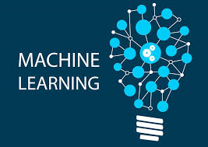
Introduction to Machine Learning Part 1
What is Machine Learning?
Machine Learning is a branch of Artificial Intelligence (AI), which helps in making machines capable of learning from observational data without being explicitly programmed.
“A computer program is said to learn from experience E with respect to some class of tasks T and performance measure P if its performance at tasks in T, as measured by P, improves with experience E.”
Tom Mitchell

Slide 7
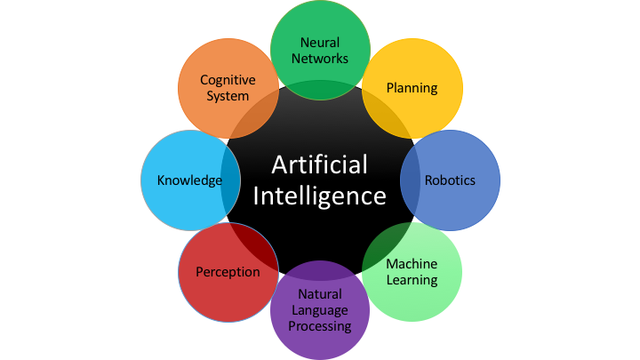
Machine learning is a component of AI !

Slide 8
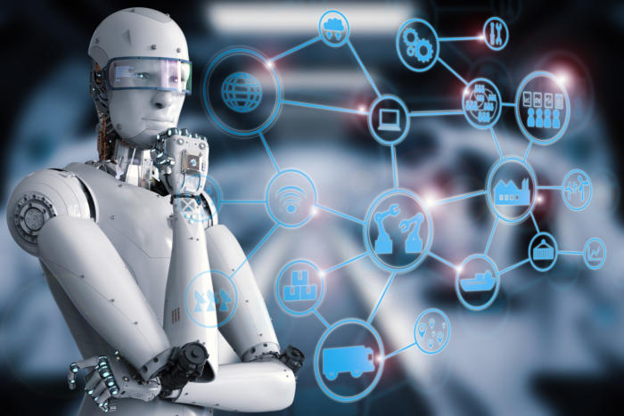
What does it actually do or why do we need ML or AI?
We want to automate certain processes using a computer.
But we’ve been automating tasks since the invention of the computer. This raises the next question.
Why is the classical way of programming a computer not sufficient?
?
?

Slide 9

The Classical Way of Programming Machines
Problem
Rules
Code
Solution
A developer or product manager analyzes the problem and figures out the rules/algorithm. This rules or Algorithm are then translated into programming code that can be run on a computer.
Examples are:
Apps, Games, Online stores, Websites, Accounting Softrwares e.t.c

Slide 10
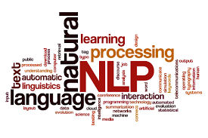
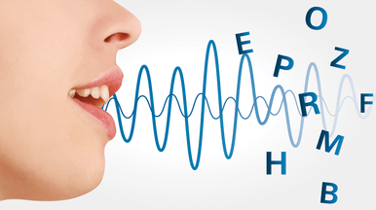

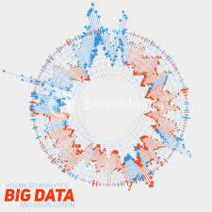

Where The Classical Approach Fails
There is a set of problems where we are not able to identify and explicitly write down these rules. This concerns problems like image and speech recognition, natural language processing, or identifying complex patterns in data.

Slide 11

Why Machine Learning?
Problem
Rules
Code
Solution
We are able to identify objects with our eyes, talk to and understand other people, read and write text, understand languages. e.t.c
But we don’t know how our brain does it, or what rules it follows.
Nature is too complex, too ambiguous, varies a lot, hence cannot be described by a finite set of explicit rules.

Slide 12
RE-DEFINING MACHINE LEARNING
Machine learning is basically an automated approach, where a machine (computer) analyzes data (images, audio, texts, etc.) for certain patterns.
The difference is that the machine figures out the rules on its own, i.e which patterns to look for (usually by analyzing many examples).
The machine learns the rules which would be impossible for a programmer to explicitly write down.

Slide 13

Where should you use Machine Learning?
Not all task requires ML!
Only Use ML when:
When classical approach fails.
When classical approach works but is computational intractable.

Slide 14
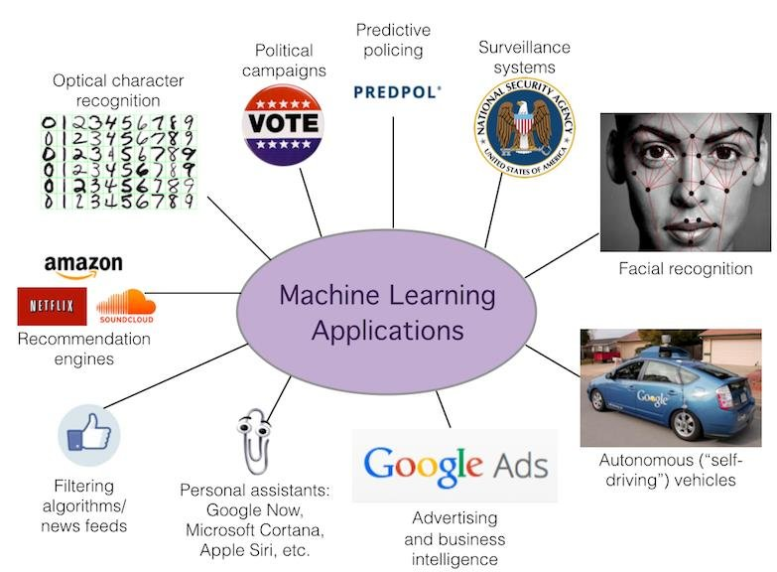
PRODUCTS THAT USE ML

Slide 15
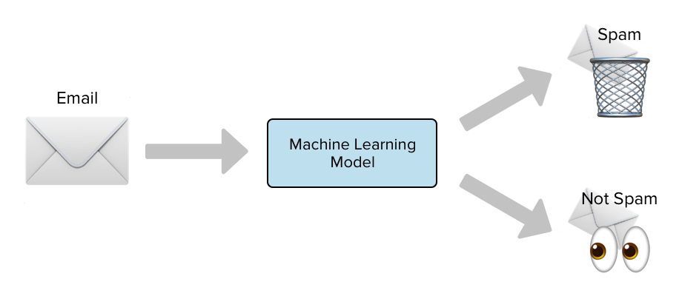
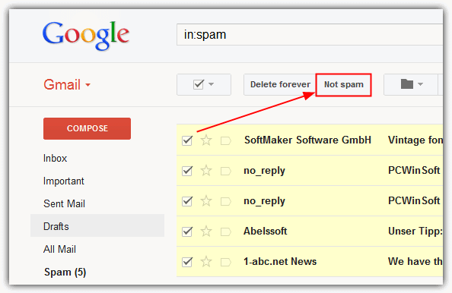
Spam Detection_products that uses ML
When Google Mail detects your spam mail automatically, it is as a result of applying machine learning techniques.

Slide 16
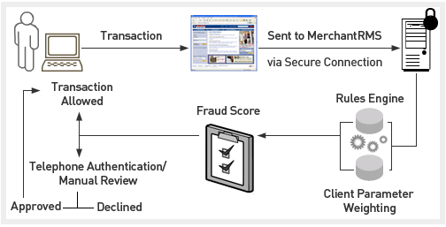

Credit Card Fraud_products that uses ML
Used by Payment Institutions to detect unusual or anomalous activities regarding customer card transactions.

Slide 17
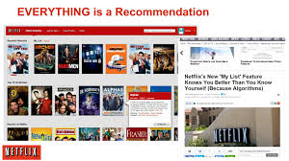
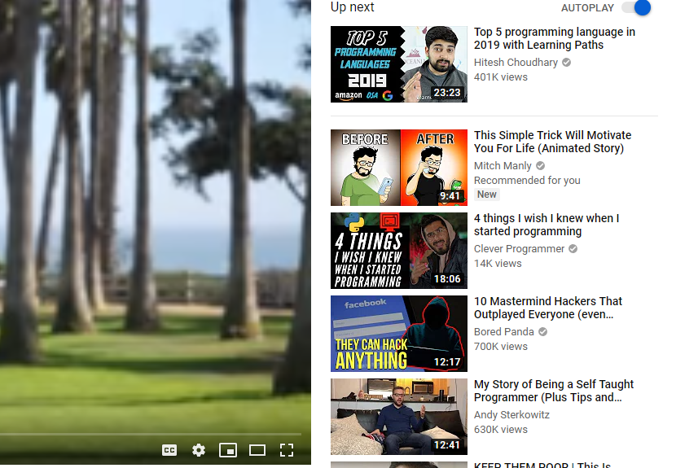
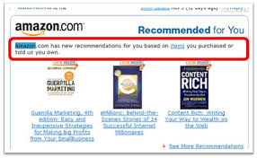
Product Recommendation_products that uses ML
When Netflix suggest movies to you, when Amazon suggest you books, or when YouTube recommend videos to you. It's not magic, its machine learning.

Slide 18
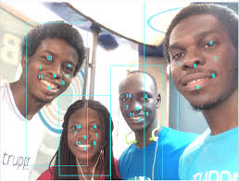
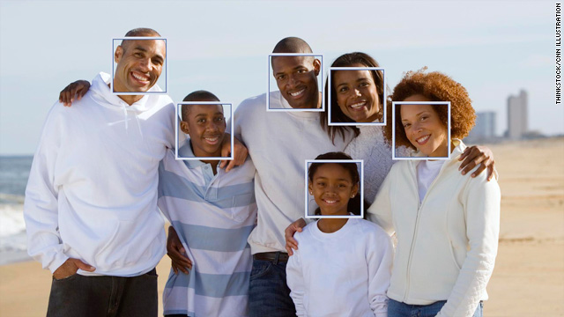
Face Detection_products that uses ML
When Facebook automatically recognizes faces of your friends in a photo, a machine learning process is what's running in the background.

Slide 19
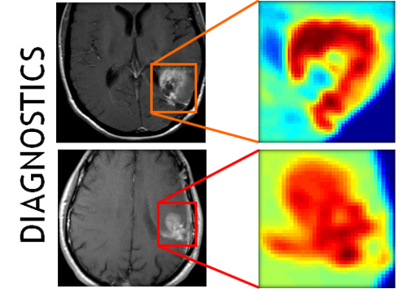
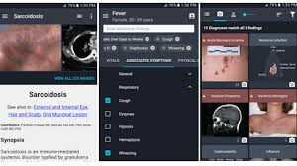
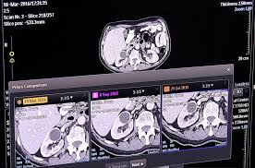
Medical Treatment/Diagnosis_products that uses ML
IBM Watson Genomics
Babylon Health for Analysis
Careskore
Google Deepmind Health for fast-track medical information
Splice Machine & QIAGEN Clinical Insight (QCI) for precision medicine
Zephyr Health for Treatment design e.t.c
Using a database of symptoms and treatments of patients, a popular machine learning problem is to predict if a patient has a particular illness.

Slide 20
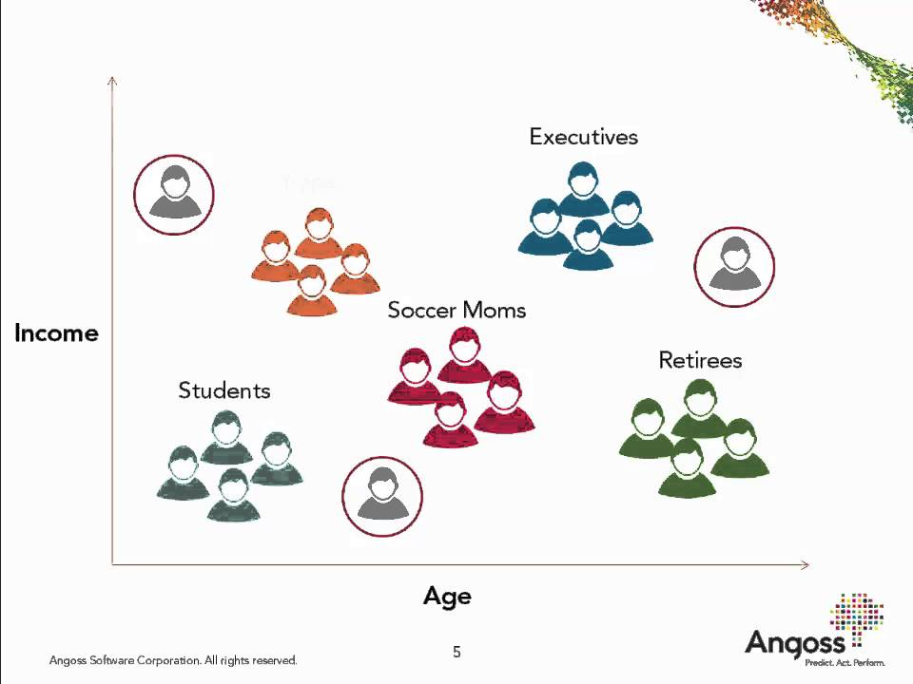
Customer Segmentation_products that uses ML
Using Income and Age data we could cluster/ segment customer into the following categories.
This is called Segmentation.

Slide 21
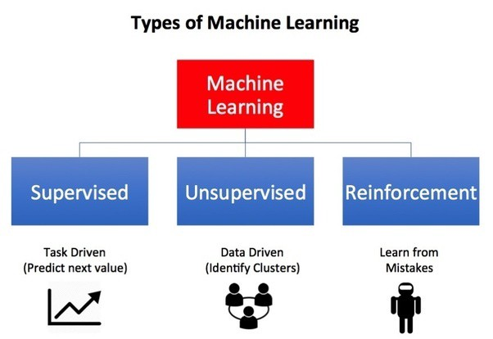
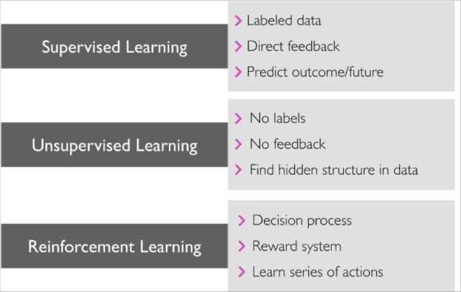
TYPES OF MACHINE LEARNING
Supervised Learning: classification and regressions problems.
Unsupervised Learning : Clustering problems
Reinforcement Learning

Slide 22
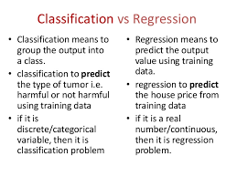
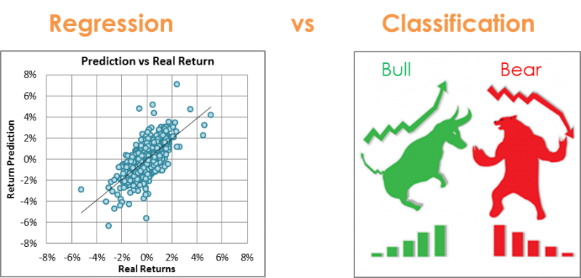
SUPERVISED LEARNING _TYPES OF MACHINE LEARNING
It consists of Classification and Regression Problems.
The target variable is known.

Slide 23
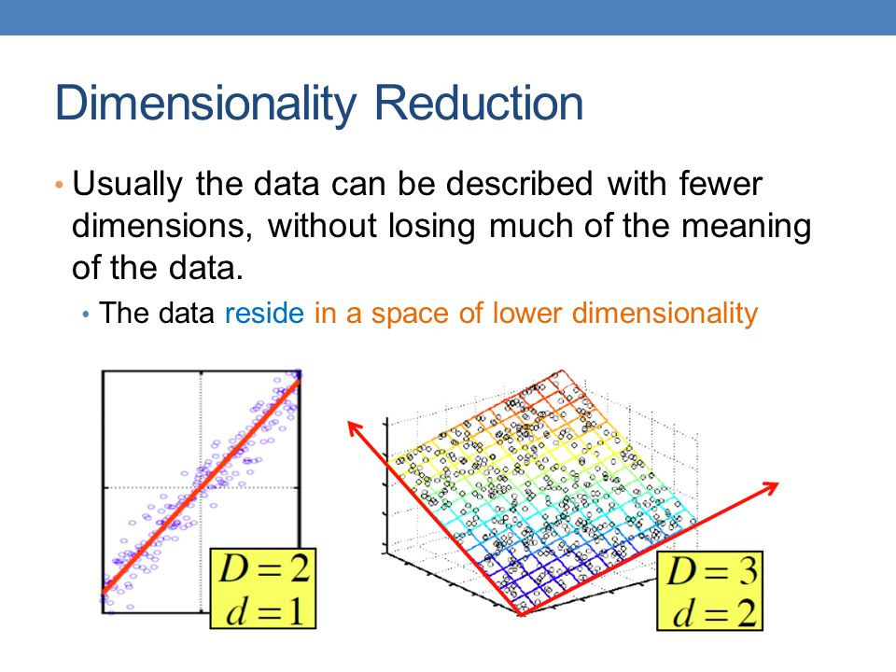
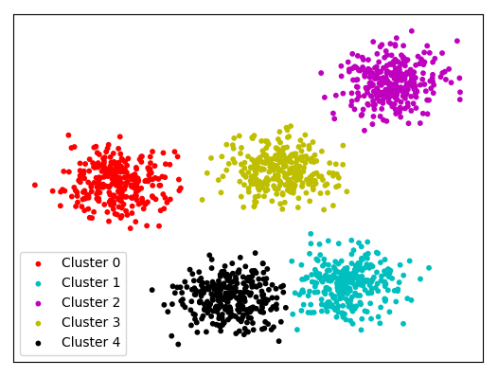
UNSUPERVISED LEARNING _TYPES OF MACHINE LEARNING
It consists of Clustering and Dimension Reduction Problems.
The target variable is unknown.
Dimensionality reduction
Clustering

Slide 24
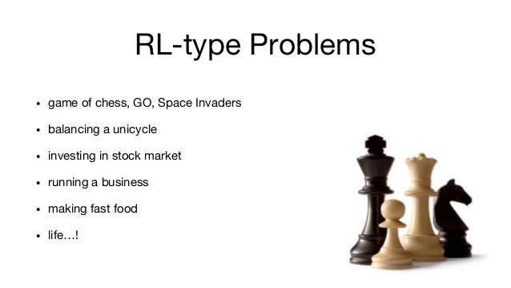
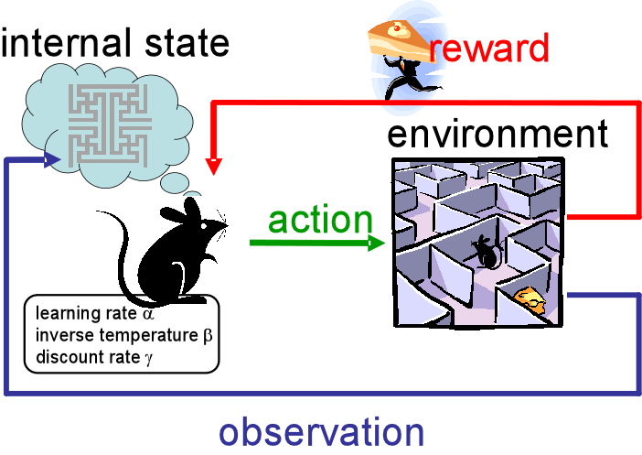
REINFORCEMENT LEARNING _TYPES OF MACHINE LEARNING
Reinforcement learning refers to goal-oriented algorithms, which learn how to attain a complex objective (goal) or maximize along a particular dimension over many steps.

Slide 25
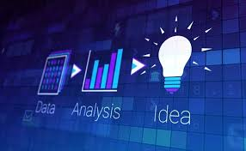
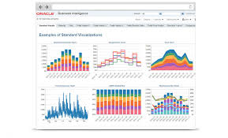
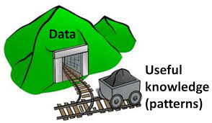
DATA ANALYTICS/ANALYSIS
Data analysis is a process of inspecting, cleansing, transforming, and modeling data with the goal of discovering useful information, informing conclusions, and supporting decision-making.
Techniques of Data Analysis:
Data Mining (Predictive Data Analysis)
Business Intelligence (Actionable Business Information)
Data Visualization (Representation of Data)
Data Analysis uses MACHINE LEARNING for Modelling!

Slide 26
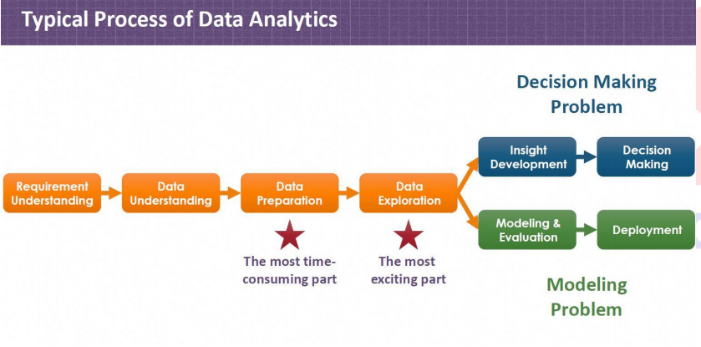

Slide 27
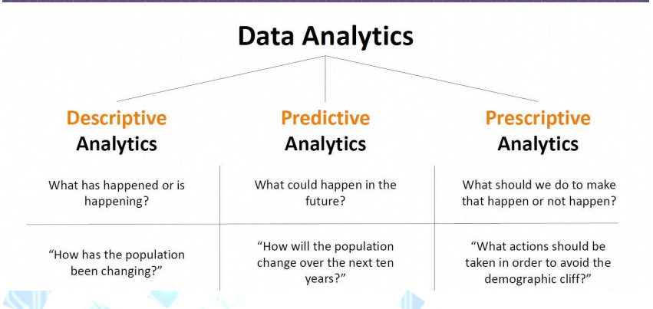
TYPES OF DATA ANALYTICS

Slide 28
END OF INTRO TO MACHINE LEARNING
NEXT UP—INTRO TO PYTHON FOR ML/DS

Slide 29

WHY PYTHON
Python was built for readability and has les complexities.
Python is easy to learn.
Lots of packages already built for Machine Learning.
Want to work with images — numpy, opencv, scikit
Want to work in text — nltk, numpy, scikit
Want to work in audio — librosa
Want to solve machine learning problem — pandas, scikit
Want to see the data clearly — matplotlib, seaborn, scikit
Want to use deep learning — tensorflow, pytorch, theano
Want to do scientific computing — scipy
Want to integrate web applications — Django
Want to take a fly …. Import antigravity

Slide 30
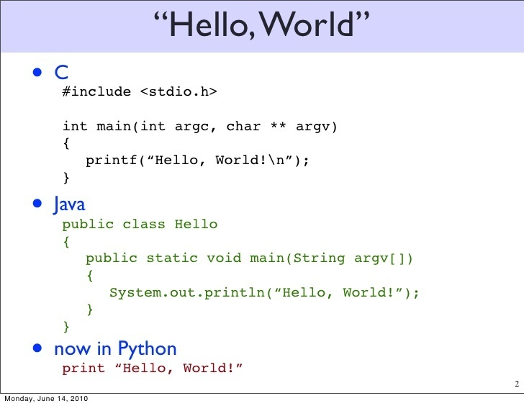
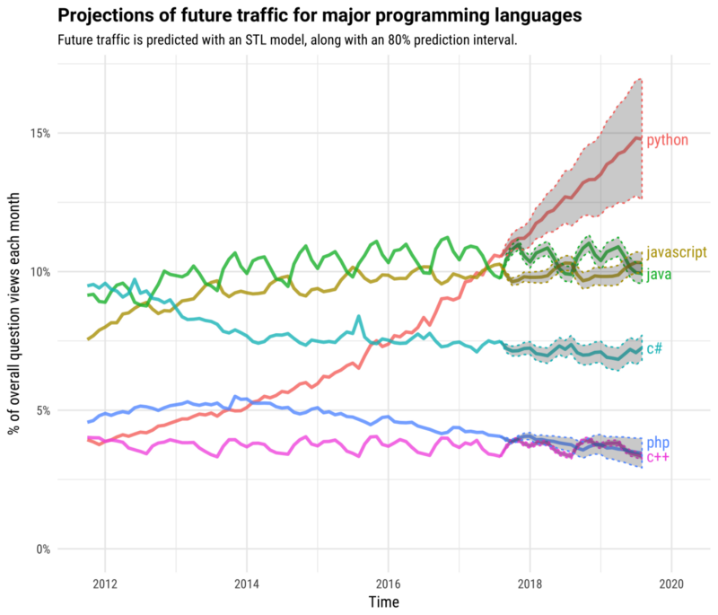
WHY PYTHON_contd
Shorter syntax.
Uses whitespaces instead of braces.
Future predictions show increased demand and use.
Source: stackoverflow developer survey

Slide 31
INTRO TO JUPYTER NOTEBOOK AND JUPYTER LAB

Slide 32

END OF DAY 1 Thank you for Listening

